Slide 2
An Introduction to big data processing with Azure Databricks
THR2182
Nishant Thacker
Technical Product Manager
@nishantthacker

Slide 3

“More than any other factor, customer experiences determine whether companies thrive and profit, or struggle and fade.”
– Forrester Research

Slide 4
Today’s customers have high expectations
Speed
79% won’t return to a slow website
Consistency
65% get frustrated with inconsistent device experiences
Personalization
38% won't call again if they have to repeat themselves

Slide 5

Harness the power of Big Data analytics apps to exceed customer needs

Slide 6
Enhance any type of app with Big Data analytics
Ecommerce apps
Gaming apps
Social apps
Business apps
IoT apps

Slide 7
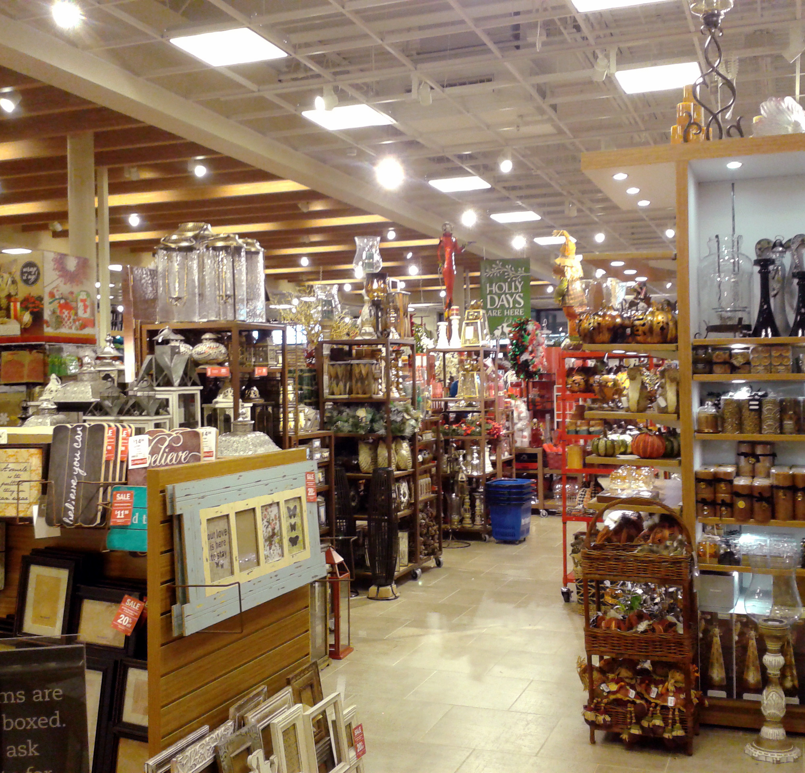

Introducing Wide World Importers

Slide 8
Wide World Importers
Wide World Importers
Currently generates profits through strong retail store sales and effective management of the brick and mortar model
But the company has a vision to dramatically increase sales through new channels
Retail stores
Physical stores with face-to-face customer service
Online shopping through company website
E-commerce directly in the consumer’s hand, anywhere

Slide 9
Wide World Importers seeks to expand customers through an omni-channel strategy
Wide World Importers
Retail stores
Web e-commerce
Mobile e-commerce
Physical stores with face-to-face customer service
Online shopping through company website
E-commerce directly in the consumer’s hand, anywhere

Slide 10
The solutions needed to reach more customers and grow the business
Scale with ease to reach more consumers
Unlock business insights from unstructured data
Enhance user experience with advanced analytics
Apply real-time analytics for instant updates
Infuse AI into apps to actively engage with customers

Slide 11

Azure Databricks
Azure Databricks is a first party service on Azure.
Unlike with other clouds, it is not an Azure Marketplace or a 3rd party hosted service.
Azure Databricks is integrated seamlessly with Azure services:
Azure Portal: Service an be launched directly from Azure Portal
Azure Storage Services: Directly access data in Azure Blob Storage and Azure Data Lake Store
Azure Active Directory: For user authentication, eliminating the need to maintain two separate sets of uses in Databricks and Azure.
Azure SQL DW and Azure Cosmos DB: Enables you to combine structured and unstructured data for analytics
Apache Kafka for HDInsight: Enables you to use Kafka as a streaming data source or sink
Azure Billing: You get a single bill from Azure
Azure Power BI: For rich data visualization
Microsoft Azure

Slide 12
Demo
Nishant Thacker

Slide 13
Azure Databricks Logical Architectures

Slide 14
Modern Data Warehouse
INGEST
STORE
PREP & TRAIN
MODEL & SERVE
Logs, files and media
(unstructured)
Azure Data Factory
Azure Blob Storage
Azure Databricks
(Python, Scala, Spark SQL)
Power BI
Polybase
Business/custom apps
(Structured)
Azure SQL Data Warehouse
Azure Analysis Services
Azure also supports other Big Data services like Azure HDInsight and Azure Data Lake to allow customers to tailor the above architecture to meet their unique needs.

Slide 15
Advanced analytics
INGEST
STORE
PREP & TRAIN
MODEL & SERVE
Azure Databricks
(Spark ML, Spark R, SparklyR)
Cosmos DB
Intelligent Apps
Logs, files and media
(unstructured)
Azure Data Factory
Azure Blob Storage
Azure Databricks
(Python, Scala, Spark SQL)
Power BI
Polybase
Business/custom apps
(Structured)
Azure SQL Data Warehouse
Azure Analysis Services
Azure also supports other Big Data services like Azure HDInsight and Azure Data Lake to allow customers to tailor the above architecture to meet their unique needs.

Slide 16
Real time analytics
INGEST
STORE
PREP & TRAIN
MODEL & SERVE
Logs, files and media
(unstructured)
Event Hub
IoT Hub
Azure Databricks
(Spark ML, Spark R, SparklyR)
Cosmos DB
Intelligent Apps
HDInsight
(Kafka)
Sensors and IoT
(unstructured)
Azure Databricks
(Python, Scala, Spark SQL)
Power BI
Batch Data
(Apps, logs)
Azure Data Factory
Azure Blob Storage

Slide 17
Thank You! nishant.thacker@microsoft.com @nishantthacker

Slide 18
Text layout (without bullet points)
Main topic: Segoe UI Semilight, size 28pt
Segoe UI, size 20pt for second level
Segoe UI, size 16pt for third level

Slide 19
Text layout with bulleted text
Main topic: Segoe UI Semilight, size 28pt
Segoe UI, size 20pt for second level
Segoe UI, size 16pt for third level

Slide 20
Example with longer headline text wrapping to a second line
When the headline text is 2 lines, move this text block down to align to the lower blue guide
If you don’t see guidelines, click on the View menu, and then check the box in front of “Guides”
Use a “soft return” Shift + Enter to wrap text without adding extra line spacing

Slide 21
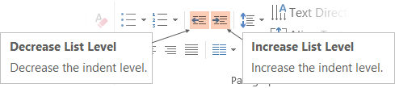
Adjusting list levels
Main topic: Segoe UI Semilight, size 28pt
Segoe UI, size 20pt for second level
Segoe UI, size 16pt for third level
Use the “Decrease List Level” and “Increase List Level” tools on the Home menu to change text levels.
Try this:
Place your cursor in the line of text that says “Segoe UI, size 20pt for second level”
Next click the Home tab, and then on the “Decrease List level” tool. Notice how the line moves up one level.
Now try placing your cursor in one of the top “Main topic…” line of text. Click the “Increase List Level” tool and see how the text is pushed in one level.
Use these 2 tools to adjust your text levels as you work

Slide 22
Bullet points layout with subtitle Set the subtitle to 20pt in the same text block, with character spacing Normal
Move the text block down vertically to align to lower guide
If you don’t see guidelines, click on the View menu, and then check the box in front of “Guides”
Hyperlink style: www.microsoft.com

Slide 23
Enter title text
Secondary text

Slide 24
Square photo layout with body text

Slide 25
Slide palette info
The PowerPoint palette for this template has been built for you and is shown below.
Avoid using too many colors in your presentation.
PowerPoint Theme Accent colors
Accent 1
Accent 2
Accent 3
Accent 4
Accent 5
Accent 6
Use Accent 1 as the main accent color.
Use Accent 2 and Accent 3 only when additional colors are needed.
Use Accents 4-6 sparingly

Slide 26
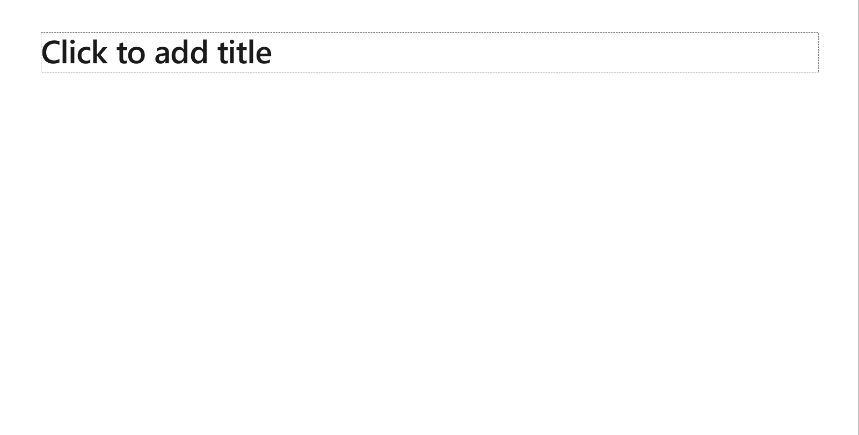
Creating accessible content
Take the following steps to create accessible content that everyone can consume effectively.
Contrast
Use high contrast colors for maximum readability
The recommended contrast ratio is at least 4.5:1
Shape and color
Use different shapes with a legend to indicate statuses to accommodate for color blindness
Example:
Alt text
Alt text helps people with screen readers understand the content of slides
You can create alternative text for shapes, pictures, charts, tables, SmartArt graphics, or other objects
Here’s how:
Right click the image or shape
Select Format Picture… or Format Shape…
Select the Size & Properties icon
Expand the Alt Text field
Enter a Title and Description of your image or object
Slide layouts
Using a built-in slide layout that matches your content ensures a hierarchical reading order of text blocks
Example:
If a new slide will have a title, rather than starting with a blank layout and adding a text block for the title, choose one of the built-in layouts with a title placeholder
Reading order
Screen readers describe content on the screen in the order it was created
To ensure your content is read back in the order you prefer, arrange your objects in the Selection Pane appropriately. Objects on the bottom of the selection pane are read first
Here’s how:
Click the Home tab
In the Drawing group, select the Arrange drop-down menu
Click Selection Pane…
Text
Text
Text
Subject 1
Subject 2
Subject 3
Color Contrast Analyzer
Download this tool to determine the legibility of text and the contrast of visual elements
Download
C1
C2
C3
Additional tips
Be sure to run the Accessibility Checker! Go to File click the Check for Issues drop down menu click Check Accessibility
Videos need to be accessible: If your presentation includes a video, ensure it is captioned and audio described (if appropriate)
Visit the Office Accessibility Center to learn more about accessibility in PowerPoint

Slide 27

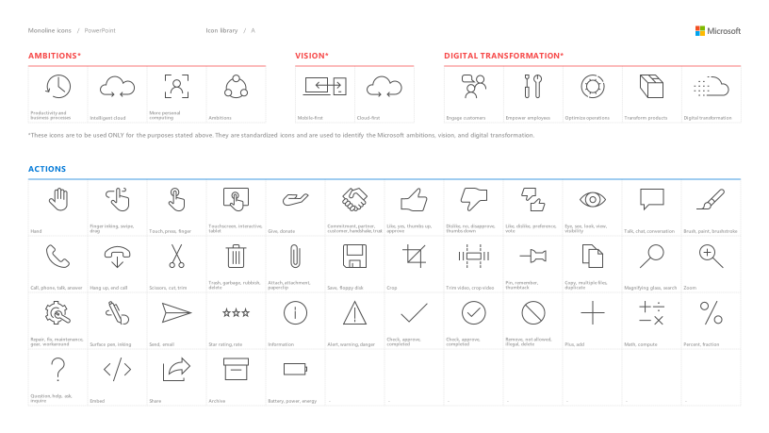
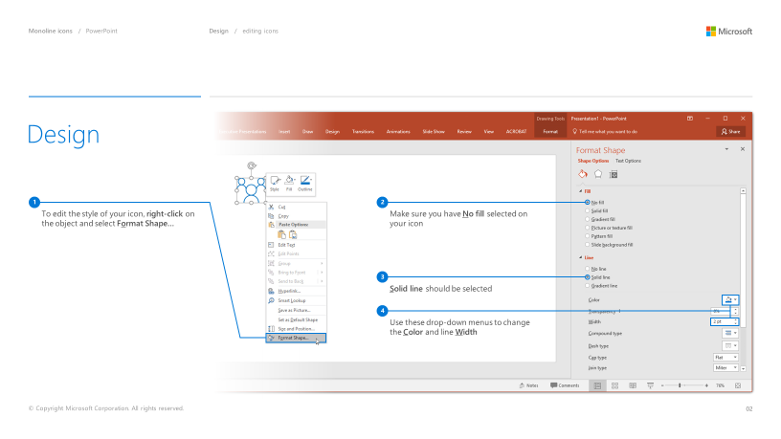
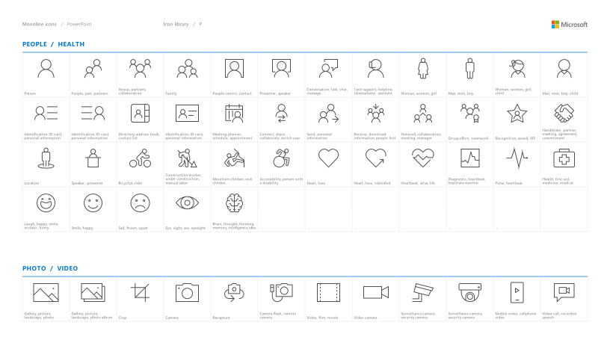
Microsoft monoline icons
Looking for icon resources?
The Monoline icon library for PowerPoint is a slide deck that provides a library of icons for use in PowerPoint presentations.
The Monoline icon style guide for PowerPoint is a pdf with additional guidelines.
Download both from Brand Central.

Slide 28
Demo
Speaker name

Slide 29
Video

Slide 30
Section title

Slide 31
Software code slide
This slide layout uses Consolas, a monotype font which is ideal for showing software code.

